Slide 1

Group 9
Customer Behavior Analysis
Insights and Recomendation
October 2024

Slide 2
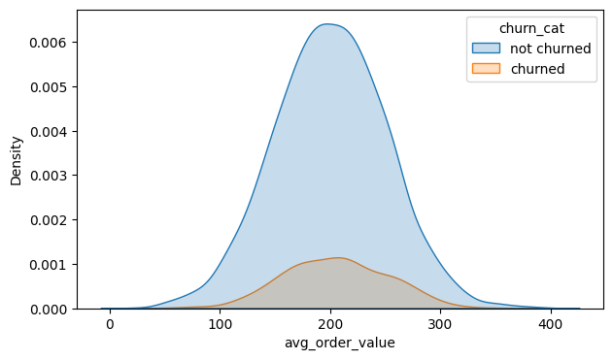
Insights
Order Values: Churned vs. Non-Churned Customers
Non-churned customers (blue) peak around 200, indicating moderate spending, while churned customers (orange) have a flatter peak with inconsistent purchases between 150 and 200, likely due to promotions.
Average Order Value of Customers

Slide 3
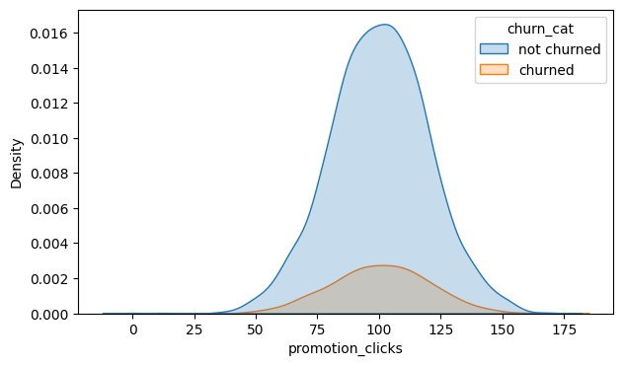
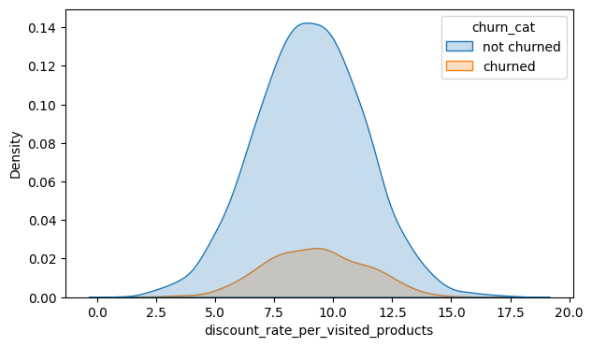
Insights
Our Customer’s Satisfaction
The charts for discount_rate_per_visited_products and promotion_clicks further strengthens the assumption that the people who churned is more concentraded around more discounts and entered the site through a promotional ads indicating the purchase of a higher order value for churned customers. Rather, consistent discounting strategies around the 8% mark might align better with customer loyalty trends

Slide 4
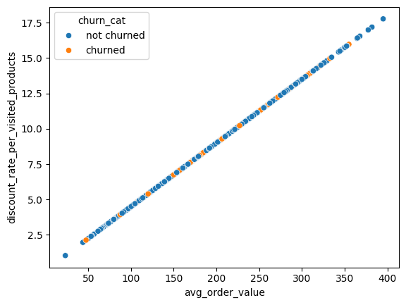
Insights
Order Values: Churned vs. Non-Churned Customers
There is a positive correlation between the avg_order_value and discount_rate_visited products where there is a steady increase in the order value with promotions. So maintaing a steady discount around 8% will maintain the order value around 200 which is the ideal value for most customers and can increase sales and profitablity
Average Order Value vs Discount

Slide 5
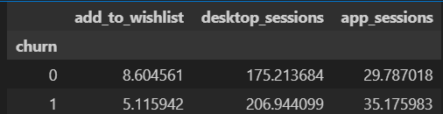
Wishlist Engagement
Insights
Non-churned customers have a higher average add_to_wishlist count (8.6) compared to churned customers (5.1). This suggests that customers who add more items to their wishlist are more engaged and likely to return, possibly due to a higher intent to purchase or revisit items of interest.
Desktop Usage Patterns
Churned customers show a higher average desktop_sessions count (206.9) than non-churned customers (175.2). This might indicate that churned users rely more heavily on desktop interactions, possibly due to a preference for longer browsing sessions or shopping on larger screens. However, increased desktop sessions alone do not seem to correlate with retention.
App Engagement
The average app_sessions count is slightly higher for churned customers (35.2) compared to non-churned customers (29.8). This could imply that merely increasing app sessions does not directly contribute to retention. Instead, engagement quality within app sessions, such as relevant recommendations or ease of use, may be more influential in encouraging customers.

Slide 6
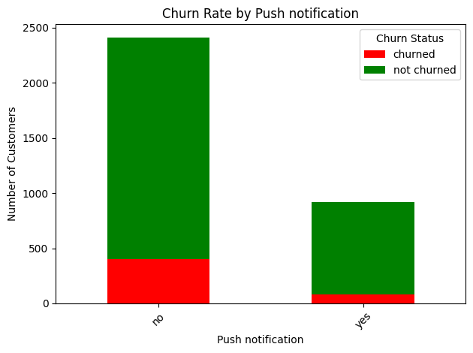
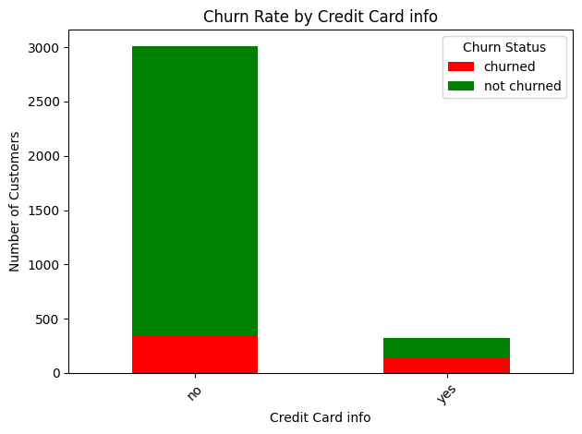
Insights
Our Customer’s Satisfaction
A significant portion of churned customers lacked push notifications (83.4%) and saved credit card information (71.6%), indicating that both reduced engagement and checkout friction contribute to higher churn rates. Implementing push notifications and encouraging saved payment details could enhance customer retention by improving engagement and streamlining the purchasing process.

Slide 7

Recomendation 1
Implement Targeted Push Notifications: Since a high percentage of churned customers (83.4%) did not have push notifications enabled, consider implementing a strategy to encourage users to opt-in. Personalized notifications about promotions, reminders for wishlist items, and relevant updates could enhance customer engagement and retention.
Encourage Saving Payment Information: Promote the benefits of saving credit card information by emphasizing security and convenience. Streamlining the checkout process for customers who save their payment details can reduce friction and improve conversion rates.
Maintain Optimal Discount Levels: To sustain an average order value around 200, implement consistent discount strategies, ideally around 8%. This balance can drive higher sales and profitability while fostering customer loyalty.

Slide 8
Recomendation 2
Focus on App Experience Quality: While churned customers have slightly higher app session counts, it’s crucial to improve the quality of those sessions. Prioritize relevant recommendations, user-friendly navigation, and a seamless browsing experience to enhance engagement and drive retention.
Analyze Promotional Strategies: Given the concentration of churned customers around discount promotions, review the effectiveness of promotional ads and their correlation with higher order values. Ensure that promotions not only attract customers but also encourage loyalty.
Monitor Engagement Metrics: Regularly assess metrics such as session duration, user interactions, and purchase behavior to identify trends. Use this data to adapt strategies in real time, focusing on improving the overall customer experience.

Slide 9
Group 9
THANK YOU
FOR YOUR NICE ATTENTION
October 2024

